Slide 1











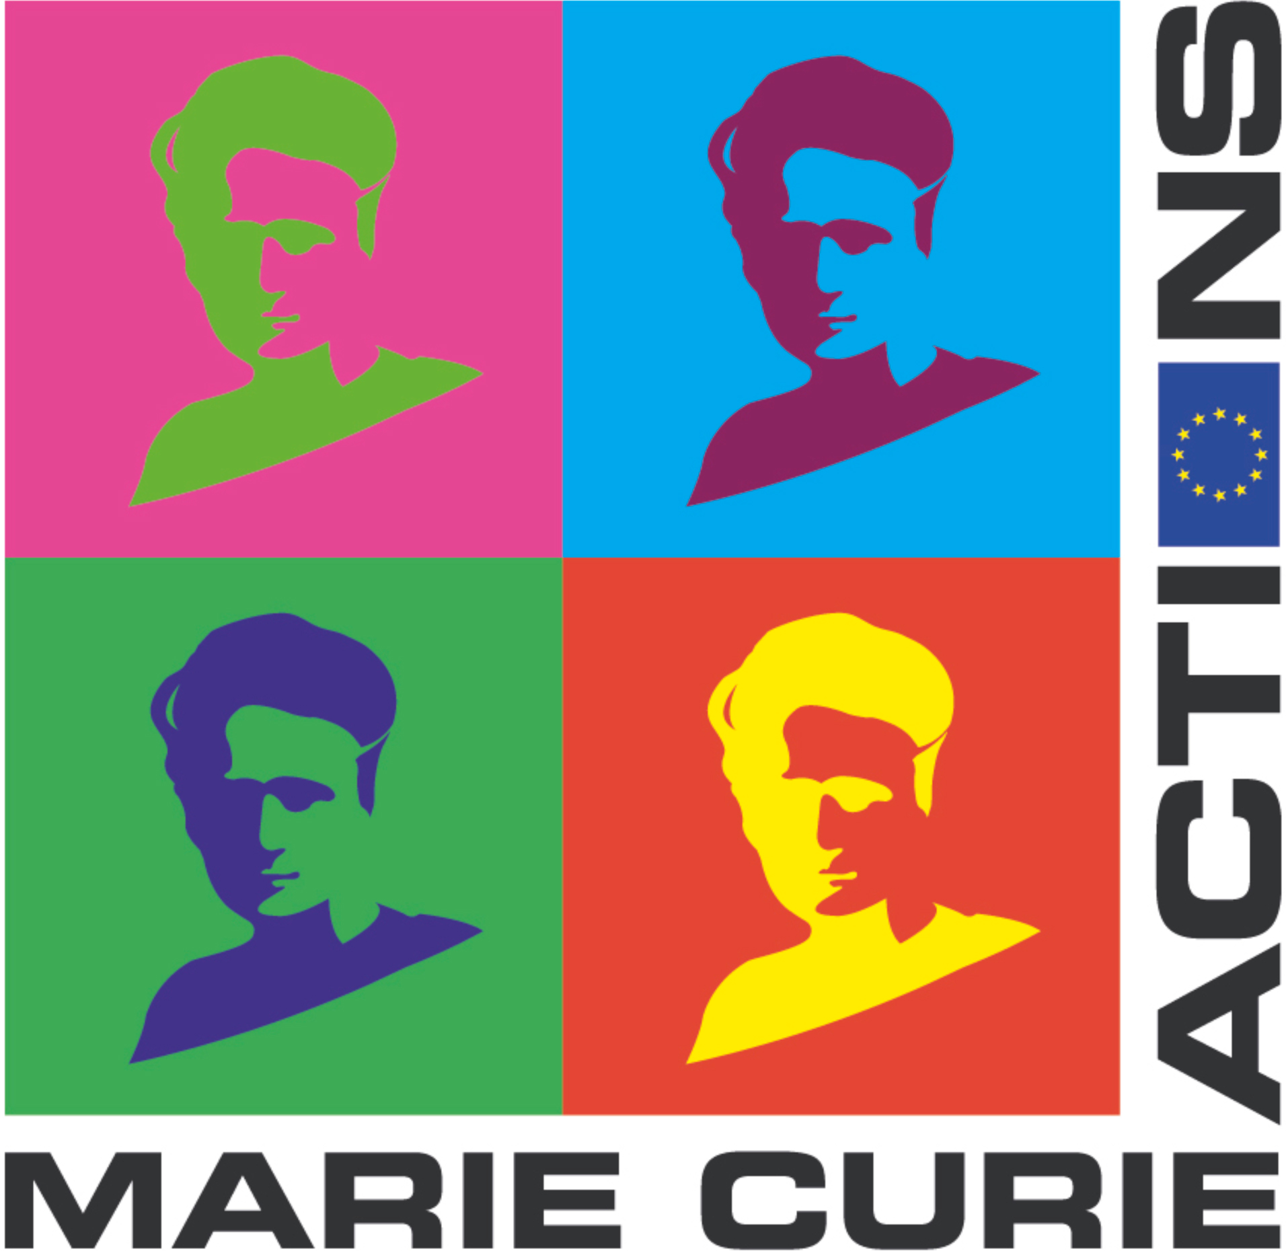


Slide 2
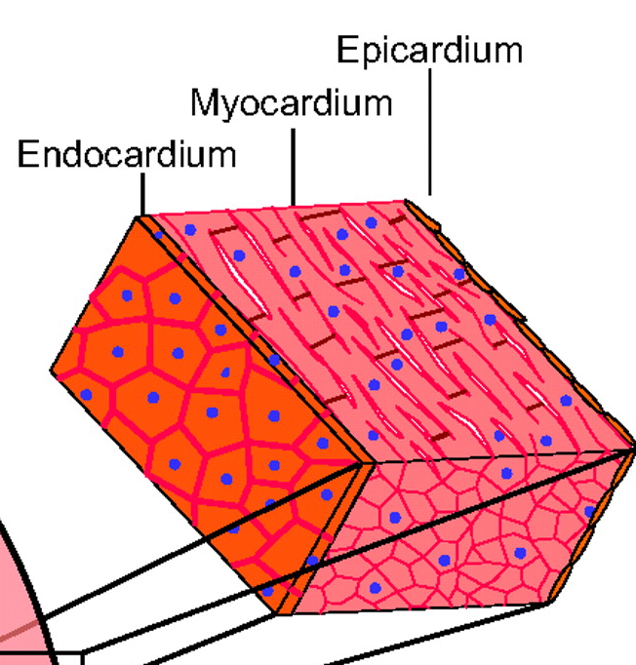
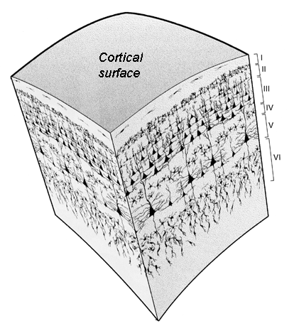
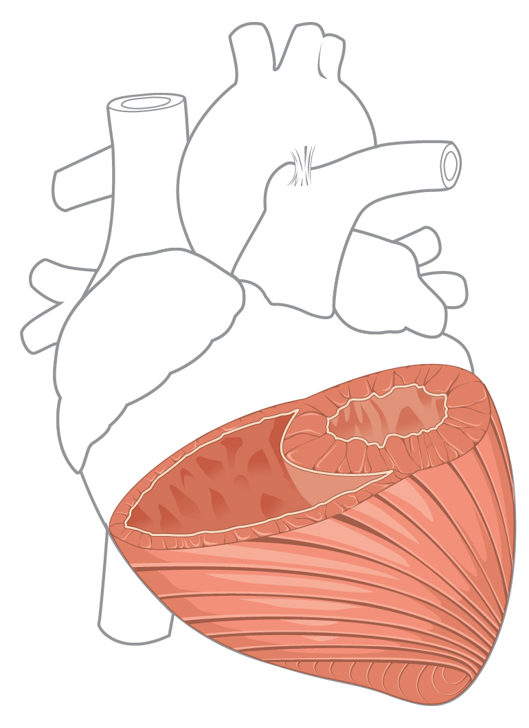
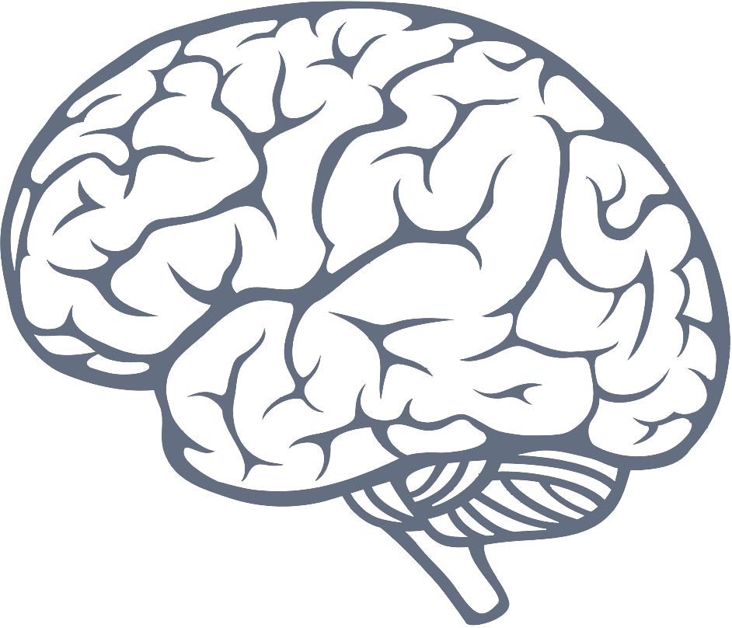
Motivation: 20’000 leagues under the surface
1 - 1.5 mm in mice
1.5-2mm in mice
Stroke
Alzheimer
Arrhythmias
Neuronal computation
Myocardial infarction
Cardiac conduction
Optical defibrillation
Notes:
Why heart and brain? Cells propagating action potentials, structure intricately related to function
100bn neurons in human brain
3bn cardiomyocytes in left ventricle 1 month after birth
'functional units of information processing.’ in humans 2-3mm
2P: 300-400um
3P could do layer 4 plus hipocampus

Slide 3
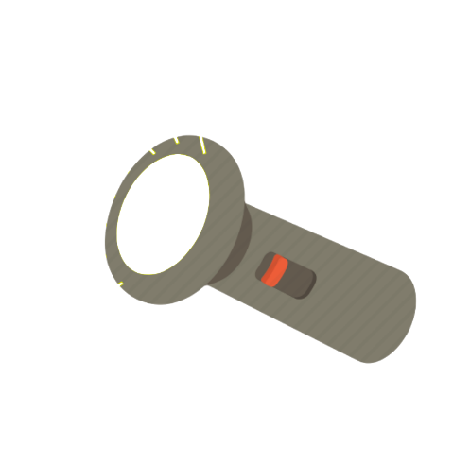
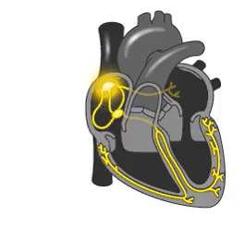
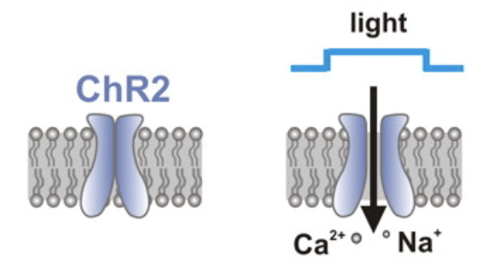
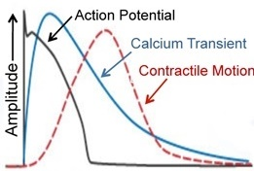
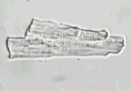
Cardiac optogenetics
Optogenetics
Optical mapping
Action Potential
100 mV
50 ms
Light-sensitive ion channels
Voltage-sensitive dyes

Slide 4
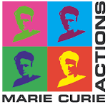
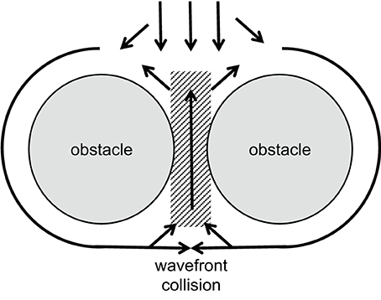
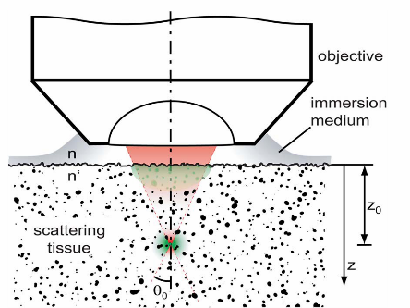
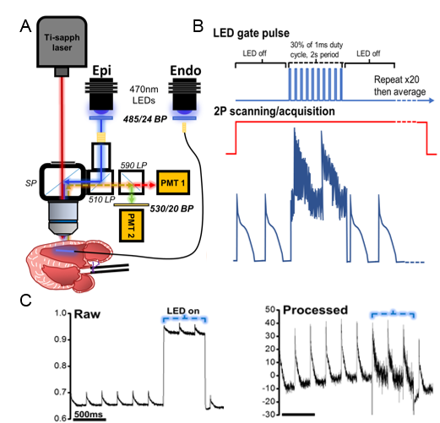
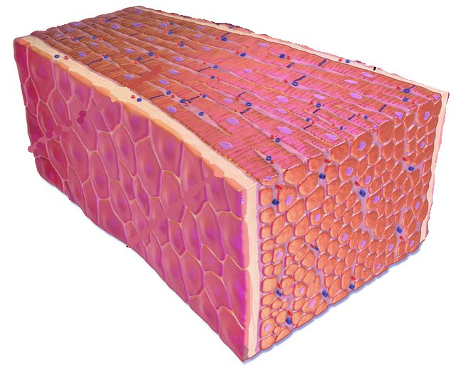
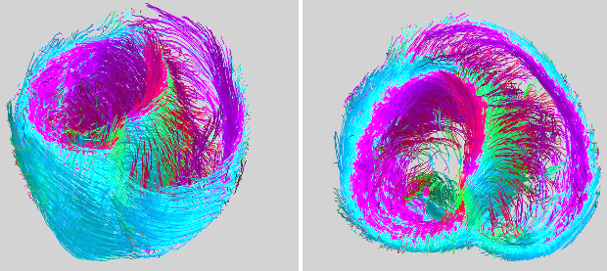
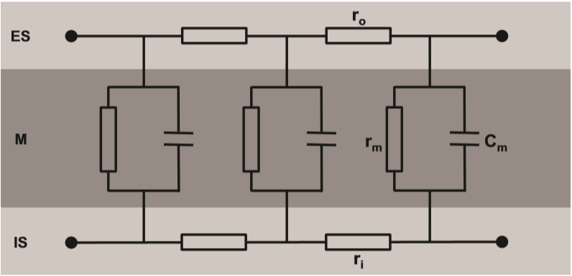
Cardiac conduction
Tissue heterogeneity
Tissue scattering
Syncytium
3D organisation
Cable theory
Notes:
Myocardial infarction scars risk of sudden cardiac death
AP goes from inside to outside

Slide 5
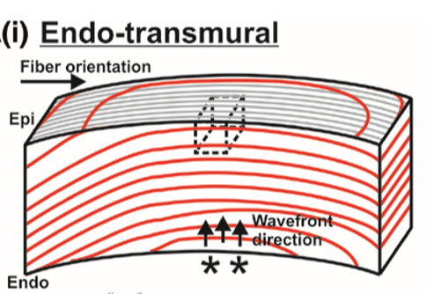
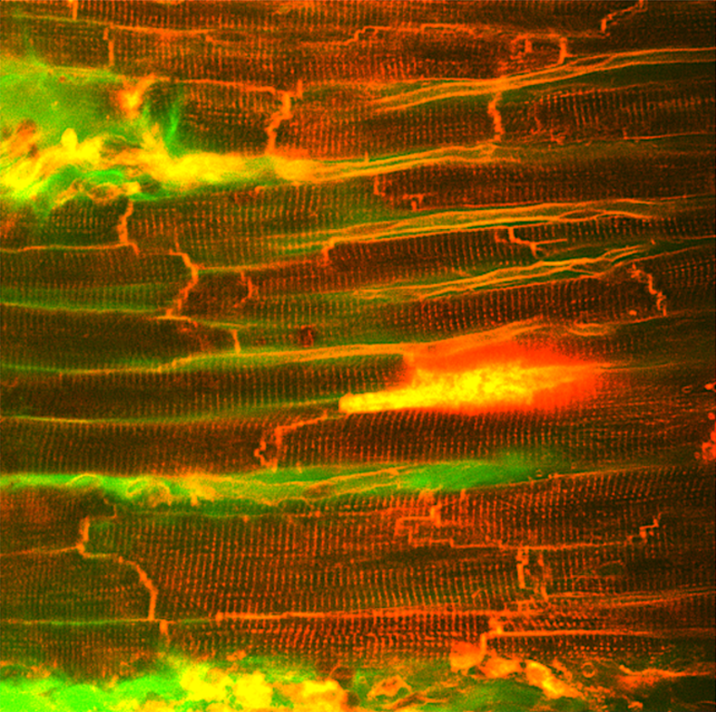
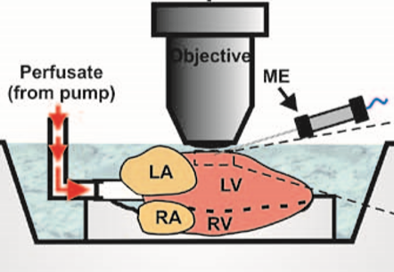
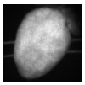
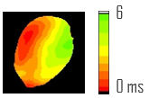
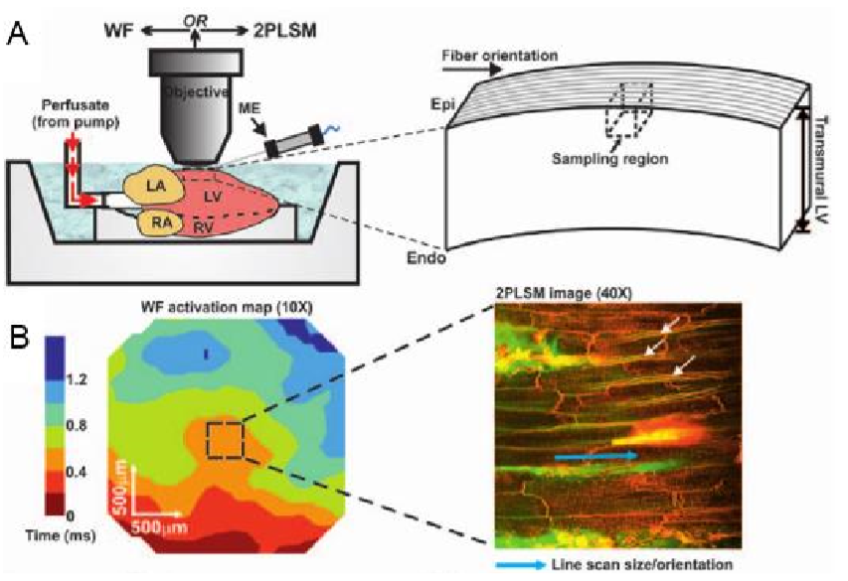
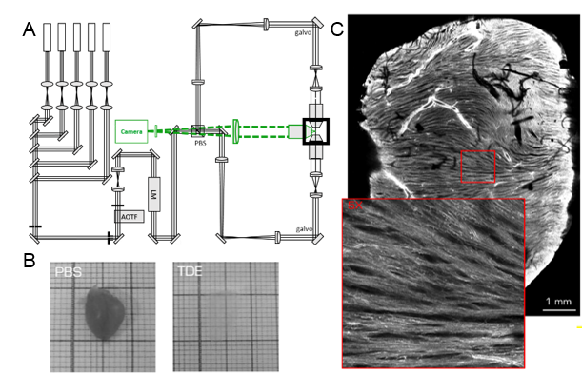
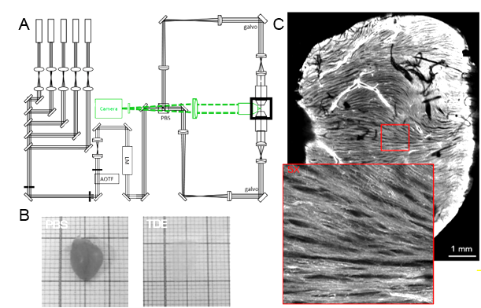
Correlation of function with structure
Langendorff perfusion
Functional imaging
Wide-field mapping
2P microscopy
Structural imaging
3D tissue heterogeneities
Optical clearing
3D cardiac conduction
Notes:
Myocardial infarction

Slide 6
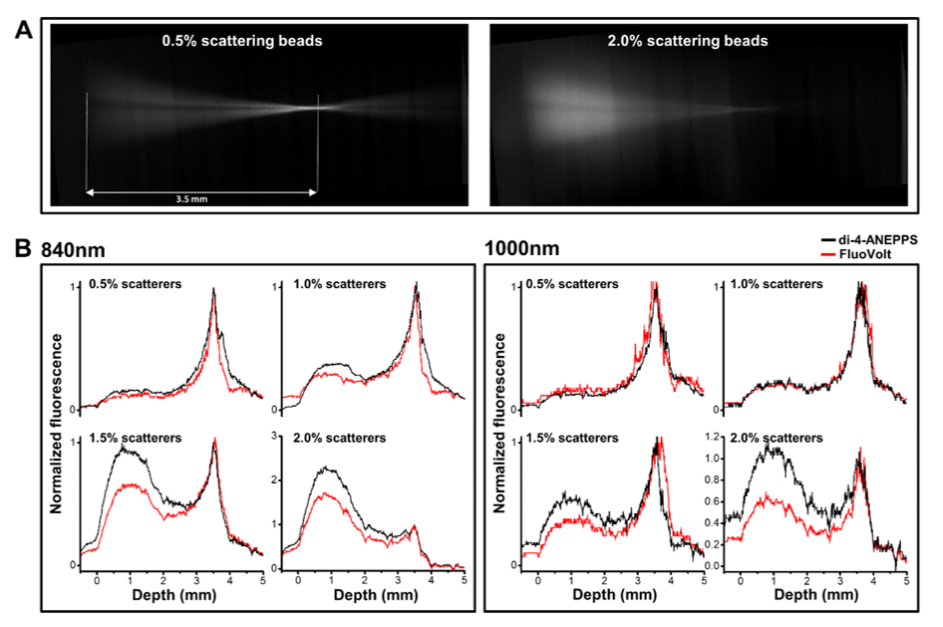
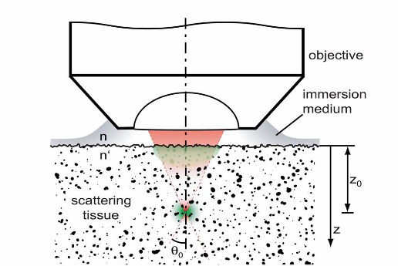
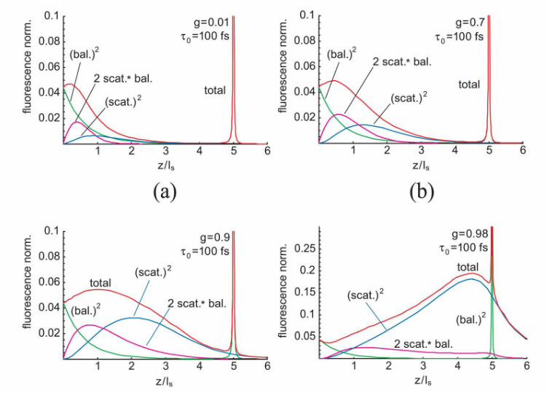
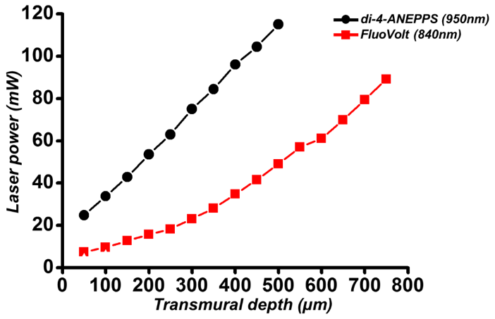
Two photon microscopy is fundamentally depth-limited
Theer and Denk JOSA 2006
Allen Kelly, Godfrey Smith MVLS- ICAMS
Salerno et al under revision

